Slide 1
Sacred Trusts
(part 4)

Slide 2
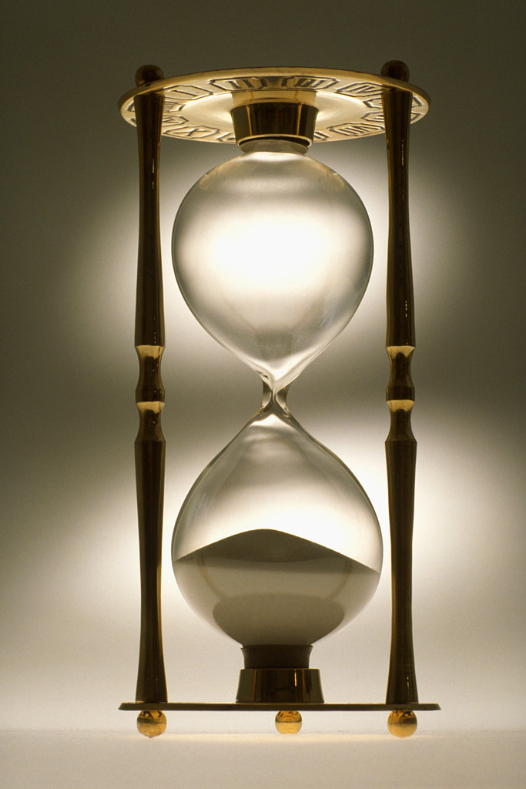
time
A precious commodity
A fleeting commodity
Sacred Measure
5

Slide 3
time
“For we have spent enough of our past lifetime in doing the will of the Gentiles—when we walked in lewdness, lusts, drunkenness, revelries, drinking parties, and abominable idolatries” (1 Pet. 4:3)
Sacred Measure
“LIFE” and “TIME” define your “LIFETIME!”
When your “life” ends, your “time” also runs out!

Slide 4
time
“For we have spent enough of our past lifetime in doing the will of the Gentiles—when we walked in lewdness, lusts, drunkenness, revelries, drinking parties, and abominable idolatries” (1 Pet. 4:3)
Sacred Measure
How your “time” on earth is used is the measurement of your “life”

Slide 5
“And these are the days…” (KJV)
“⁷ This is the sum of the years of Abraham’s life which he lived: one hundred and seventy-five years. ⁸ Then Abraham breathed his last and died in a good old age, an old man and full of years, and was gathered to his people” (Gen. 25:7, 8)
Life ought to be measured in “days” rather than “years!”
“Give us this day our daily bread” (Matt. 6:11)
Notes:
We often only think of a person’s life in years. But the more scriptural measurement in life is the day. Abraham’s life was measured in days. Our life is filled with daily decisions and daily choices.
We cannot assume tomorrow, let alone “next year” (Is. 56:12; Jas. 4:13, 14).

Slide 6
“And these are the days…” (KJV)
“⁷ This is the sum of the years of Abraham’s life which he lived: one hundred and seventy-five years. ⁸ Then Abraham breathed his last and died in a good old age, an old man and full of years, and was gathered to his people” (Gen. 25:7, 8)
Life ought to be measured in “days” rather than “years!”
“Therefore we do not lose heart. Even though our outward man is perishing, yet the inward man is being renewed day by day” (2 Cor. 4:16)
Notes:
We often only think of a person’s life in years. But the more scriptural measurement in life is the day. Abraham’s life was measured in days. Our life is filled with daily decisions and daily choices.
We cannot assume tomorrow, let alone “next year” (Is. 56:12; Jas. 4:13, 14).

Slide 7
time
“So teach us to number our days, That we may gain a heart of wisdom” (Ps. 90:12)
Sacred Measure

Slide 8
Why Should We Number Our Days To Gain A Heart of Wisdom?
Because the only lasting place is in the Lord (90:1, 2)
Because God can turn man into destruction (90:3)
Because the view of time can be deceitful for man (90:4)
If we lived to be as old as Methuselah, our time would only be but a moment for God (2 Pet. 3:8)
“When it is past”
how is time viewed “when it is past” versus “when it is anticipated?”

Slide 9
Why Should We Number Our Days To Gain A Heart of Wisdom?
Because man’s time is so frail (90:5, 6)
Because all our sins are placed before God (90:7, 8)
Because the strength of our years boast only in the sigh of sorrow (90:9, 10)
Because the infirmities of this life do not compare with the miseries of the next for those not reconciled to God (90:11)
Likewise, “For I consider that the sufferings of this present time are not worthy to be compared with the glory which shall be revealed in us” (Rom. 8:18)

Slide 10
Ephesians 5:15, 16
“See then that you walk circumspectly, not as fools but as wise, redeeming the time, because the days are evil.”
We are called to walk carefully
Do not walk like a fool
Redeem the time—buy it back
“Because the days are evil”
Which is why we must walk so as to grow to not fall (2 Pet. 3:17, 18)
Sin wastes our life away…coasting to hell
Notes:
Walking circumspectly and cautiously. Like walking on a sidewalk by a busy street. We tell our children to stay on the sidewalk. When we must cross a street, we look both ways. Do not walk so close to the street so that if you fall, you land near a passing vehicle. But enjoy the walk. Enjoy the together time, enjoy the scenery, enjoy the exercise.
In the same way we are to walk in this life, guarded but also seeking to make the most out of it.

Slide 11
Adam Clarke
“Buying up those moments which others seem to throw away; steadily improving every present moment, that ye may, in some measure, regain the time ye have lost. Let time be your chief commodity; deal in that alone; buy it all up, and use every portion of it yourselves. Time is that on which eternity depends; in time ye are to get a preparation for the kingdom of God; if you get not this in time, your ruin is inevitable; therefore, buy up the time.”

Slide 12
Redeem Your Time!
By understanding what the Lord’s will is (Eph. 5:17)
By filling your life with the Holy Spirit rather than wasting it with “spirits” (Eph. 5:18)
The fool’s life versus the Christian’s
“Drunk with wine” versus “filled with the Spirit”
Dissipation (profligacy) versus redeeming the time -Luke 15:13, 14
By walking wisely among those outside (Col. 4:5)
By spending time in family togetherness and instruction (Deut. 11:18-21; Prov. 3:1-6; 4:10-13)

